Slide 1
Project Title: AGG Reliability Improvement/No Trips for 90 days
Charter Template
Business Case/Objectives:
Sustain asset reliability and availability
Need to reduce gas flaring at AGG due to multiple trips and re-starts.
Stabilize and sustain production volumes, increase FCF
Need to reduce HSSE exposure of CRO/field operators and maintenance personnel due to multiple station starts.
Need for increase in wrench time of field operations/maintenance personnel.
Potential Benefits & Measurement:
Improved FCF
Production & Resource Optimisation (Improved capacity utilization)
Upskilling of operations/maintenance personnel on proactive and RTM tools and processes
Project Scope/Actions :
Improve proactive threat monitoring across all AGG systems(RTM, SOS)
Implement L5,L6 and L7 on Smart connect on key AGG equipment
Implement critical spares list on key AGG equipment
Critical Success Factors:
Appointment of SOS Equipment owners
Weekly/Monthly review and KPI monitoring dashboard developed
90% tag update and alignment on PI/Smartconnect
Harmonised critical spares list Go-Live
90 days without trip****
High-level Timeline:
L0-L1: July 2019
L2: August 2019
L3: August 2019
L4: September 2019
L5: October 2019
Initiative End
Project Sponsor: Onyeka, Ikechukwu
Implementation Lead: Ekpudu Larry
Project Team: Ekpudu Larry, Arowosafe Odewale, Salami Tayo, Udo Uzochukwu, Ogba Okpako, Ukenye Sunday, Maduka Uche

Slide 2
Weekly cadence commitment template
No. | Action | Action Party | Threat | Due Date | Status
1-1.1
1-1.2
1-1.3
1-1.4
1-1.5

Slide 3
Weekly cadence commitment template past 7 days
No. | Action | Action Party | Threat | Due Date | Status
10-4.1 |  |  |  |  | New
10-4.2 |  |  |  |  | New
10-4.3
10-4.4
10-4.5
10-4.6
10-4.7
10-4.8
10-4.9
10-4.10
10-4.11
10-4.12
10-4.13
10-4.14
10-4.15
10-4.16

Slide 4
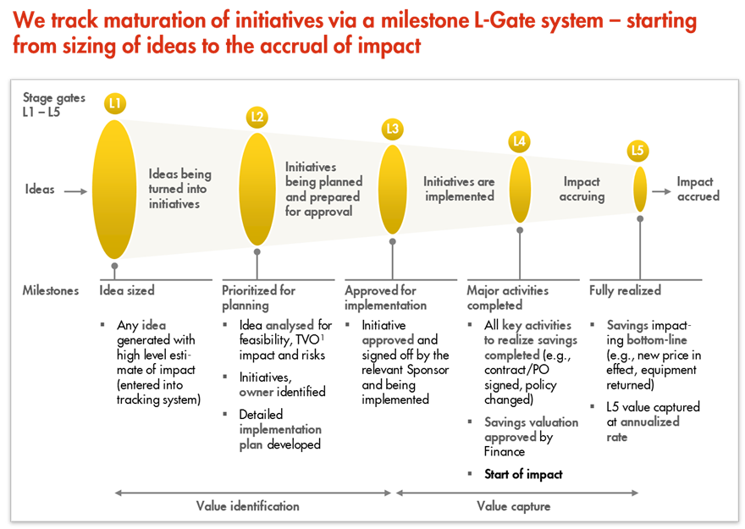
L1 – L5 Gates

